Slide 1


RESOURCE
‘Bleed’ in Design
This template is to be used in a flexible way to suit the needs of the presentation. You can add images, colour and graphic elements as needed.

Slide 2
What is Bleed?
In printing, bleed is printing that goes beyond the edge of where the sheet will be trimmed. In other words, the bleed is the area to be trimmed off. The bleed is the part on the side of a document that gives the printer a small amount of space to account for movement of the paper, and design inconsistencies. Artwork and background colors often extend into the bleed area. After trimming, the bleed ensures that no unprinted edges occur in the final trimmed document.
It is very difficult to print exactly to the edge of a sheet of paper/card. To achieve this, it is necessary to print a slightly larger area than is needed and then trim the paper/card down to the required finished size. Images, background images and fills which are intended to extend to the edge of the page must be extended beyond the trim line to give a bleed.
Bleed size can vary from one print company to another and depend on the size of the document. For example, a business card will generally have a smaller bleed than an A1 poster. Some printers ask for specific sizes; most of these companies place the specific demands on their website or offer templates that are already set to their required bleed settings.
https://en.wikipedia.org/wiki/Bleed_(printing)

Slide 3
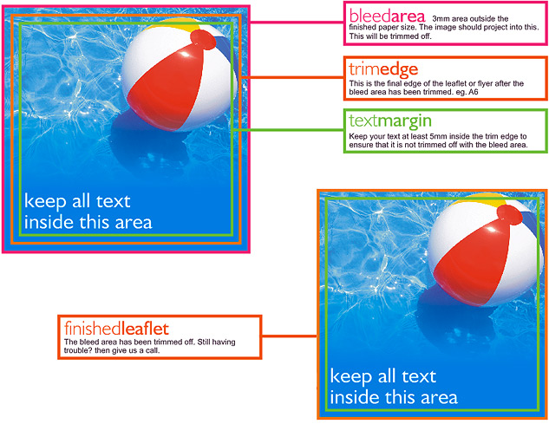
http://www.precisionprint.co.uk/resources/bleed
Virtu Design Institute Pty Ltd (RTO 40530 - ABN 31 154 273 757) trading as APC Design School
Young Rabbit Pty Ltd (ABN 28 003 381 182) trading as Australian Pacific College | RTO Code: 90396 | CRICOS Provider Code: 01331F

Slide 4

What is Bleed?
https://www.youtube.com/watch?v=ZuNrmgv8rjQ
Virtu Design Institute Pty Ltd (RTO 40530 - ABN 31 154 273 757) trading as APC Design School
Young Rabbit Pty Ltd (ABN 28 003 381 182) trading as Australian Pacific College | RTO Code: 90396 | CRICOS Provider Code: 01331F

Slide 5

Adding Bleed in Adobe Illustrator
https://www.youtube.com/watch?v=LG_O_7n6Hmw
Virtu Design Institute Pty Ltd (RTO 40530 - ABN 31 154 273 757) trading as APC Design School
Young Rabbit Pty Ltd (ABN 28 003 381 182) trading as Australian Pacific College | RTO Code: 90396 | CRICOS Provider Code: 01331F

